Slide 1


Slide 2

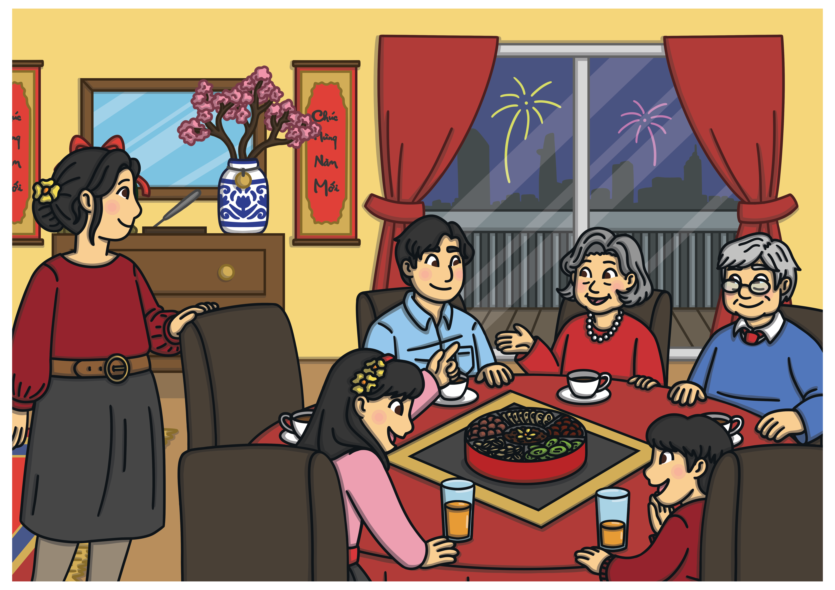
How can we say this in English?
family
Reveal Answer

Slide 3
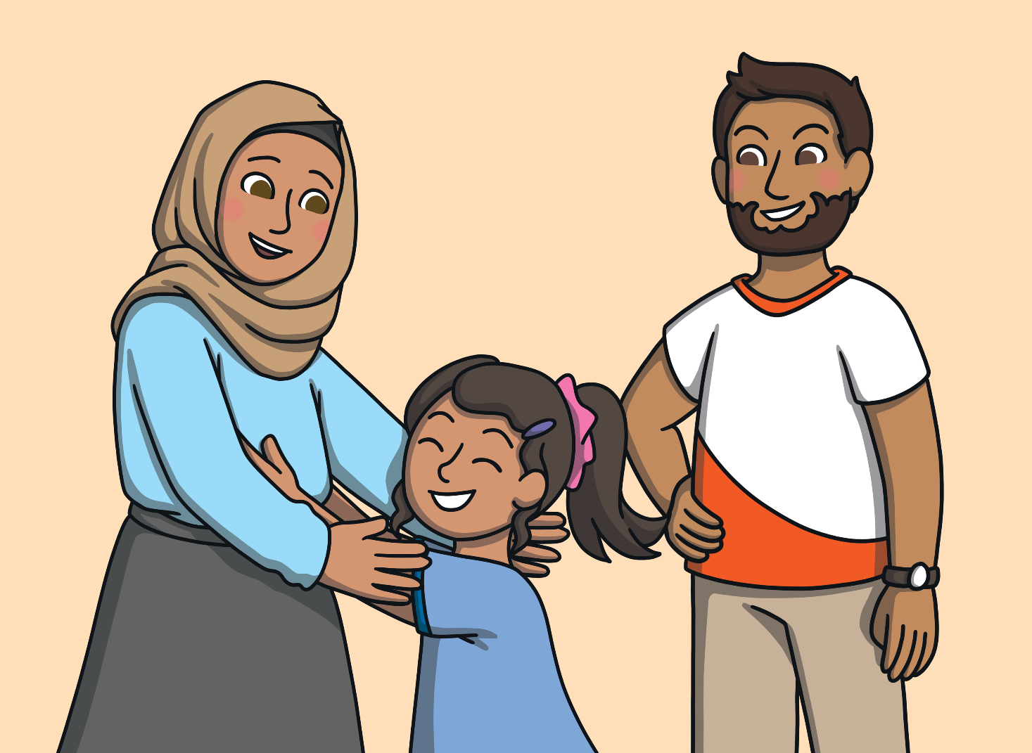
Who is this?
mum
Reveal Answer

Slide 4
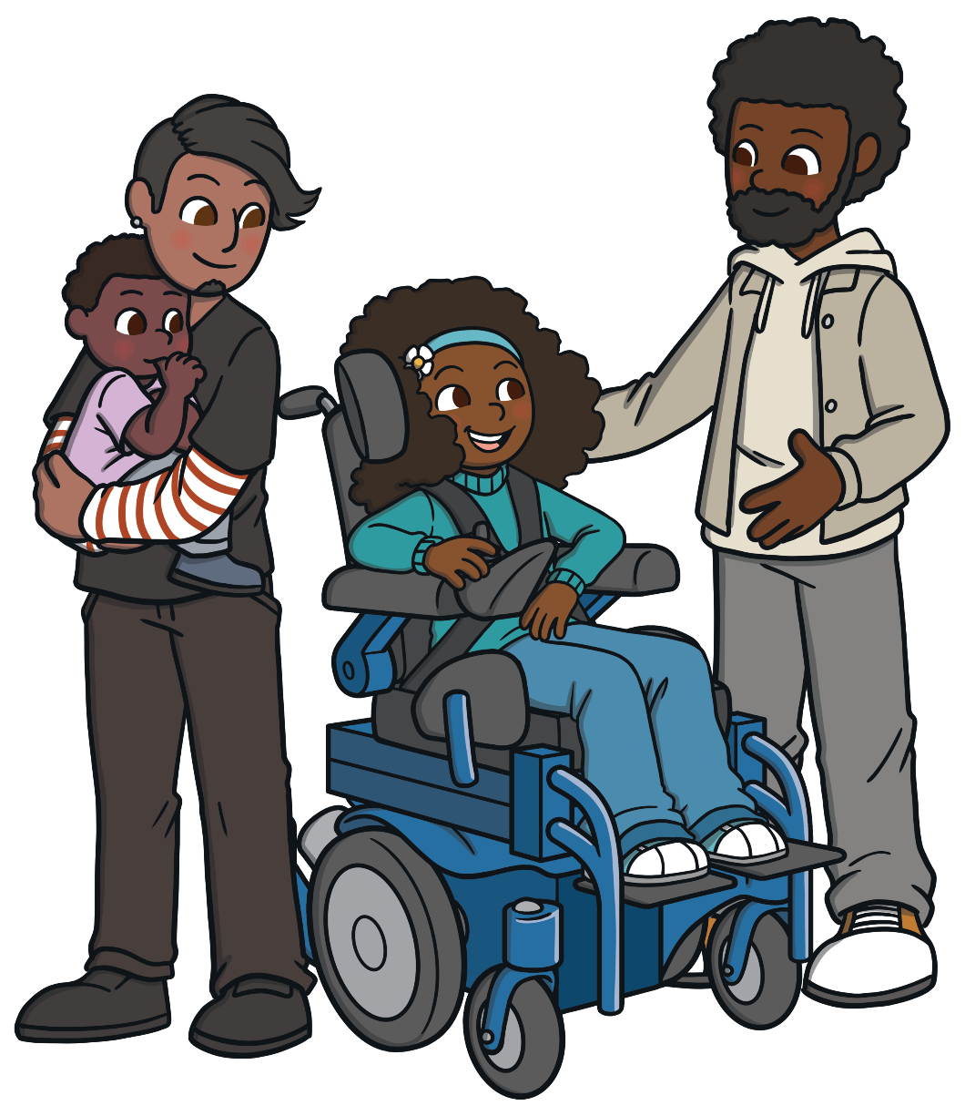
Who is this?
dad
Reveal Answer

Slide 5
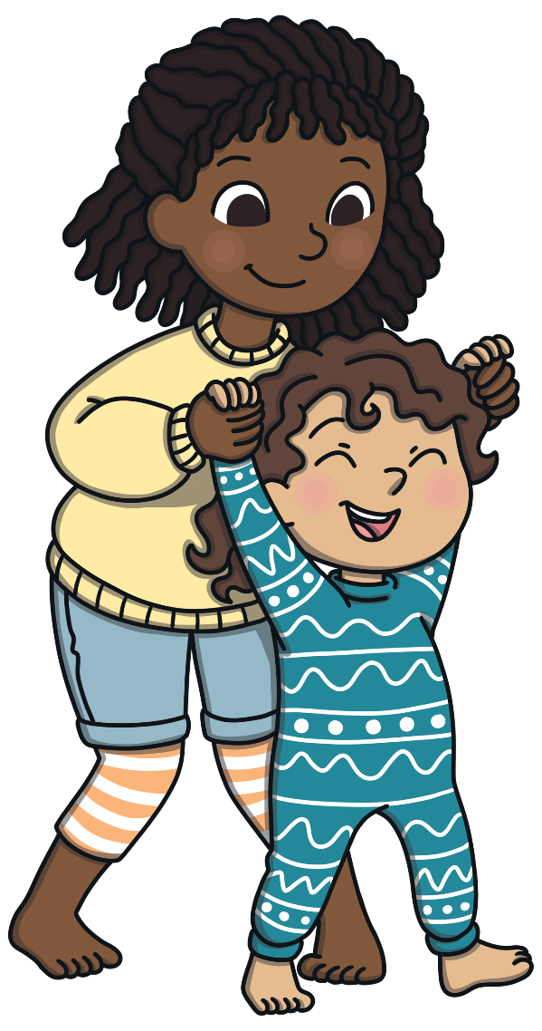
Who is this?
sister
Reveal Answer

Slide 6
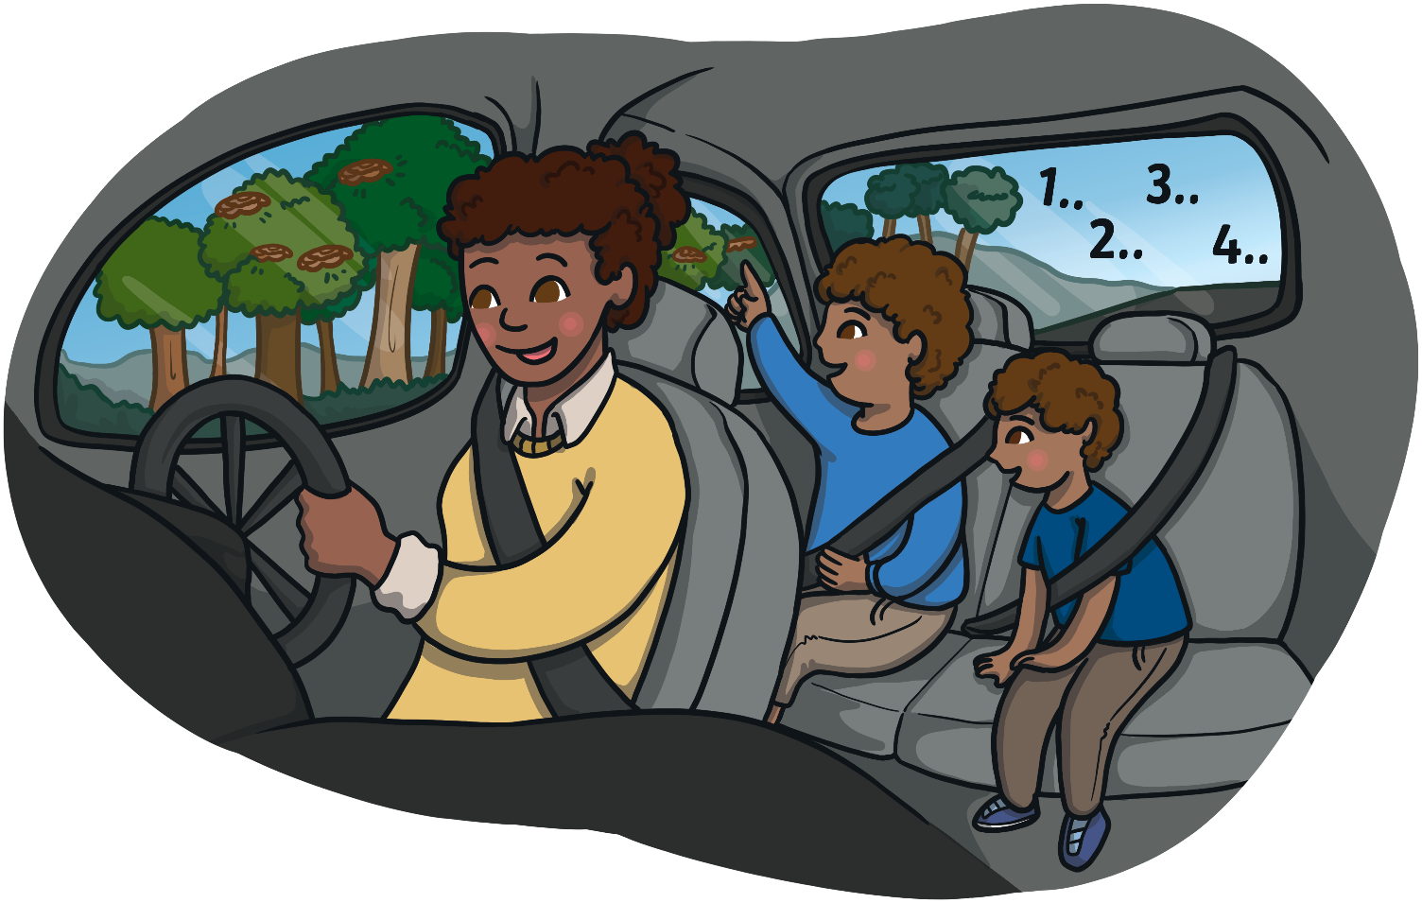
Who is this?
brother
Reveal Answer

Slide 7
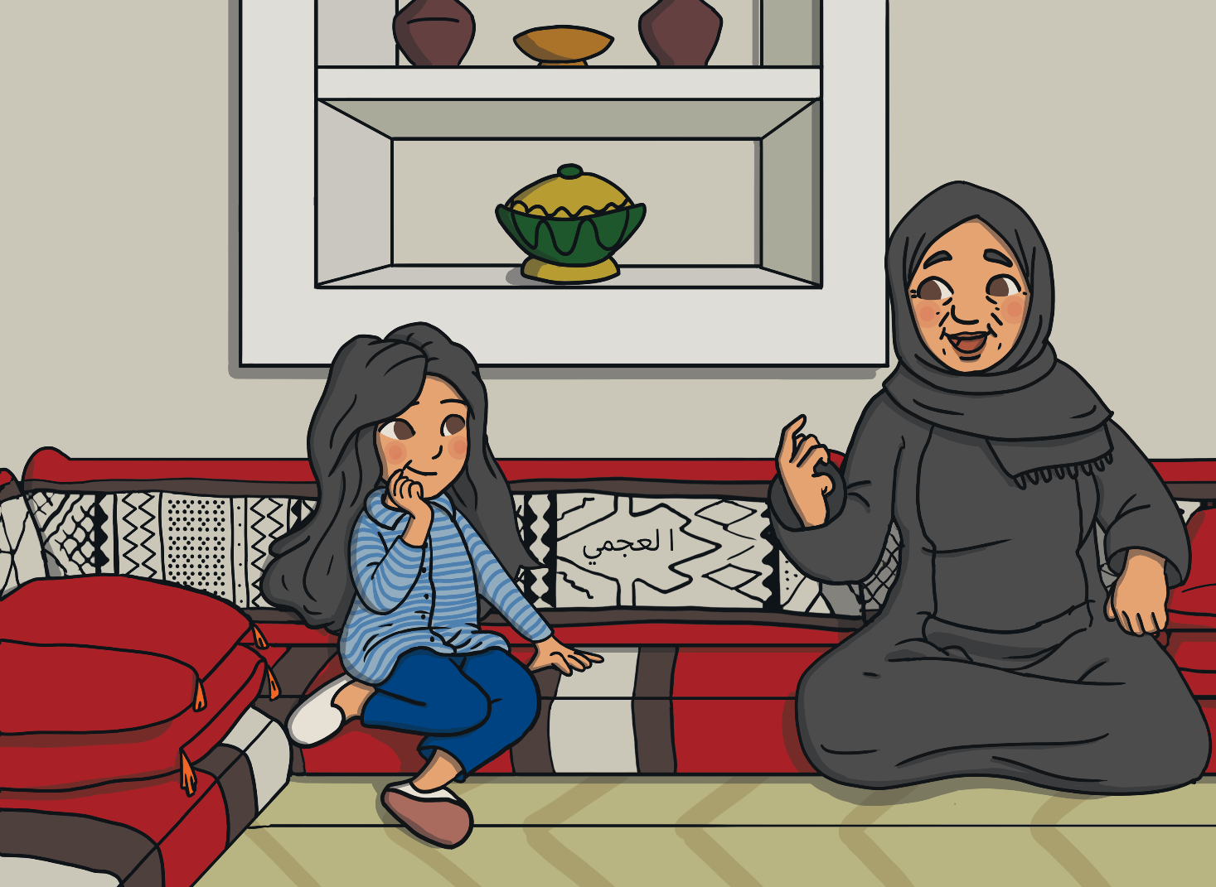
Who is this?
grandma
Reveal Answer

Slide 8
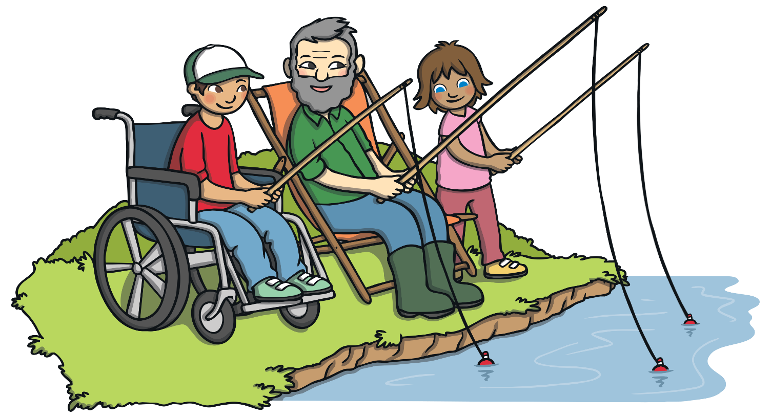
Who is this?
grandpa
Reveal Answer

Slide 9

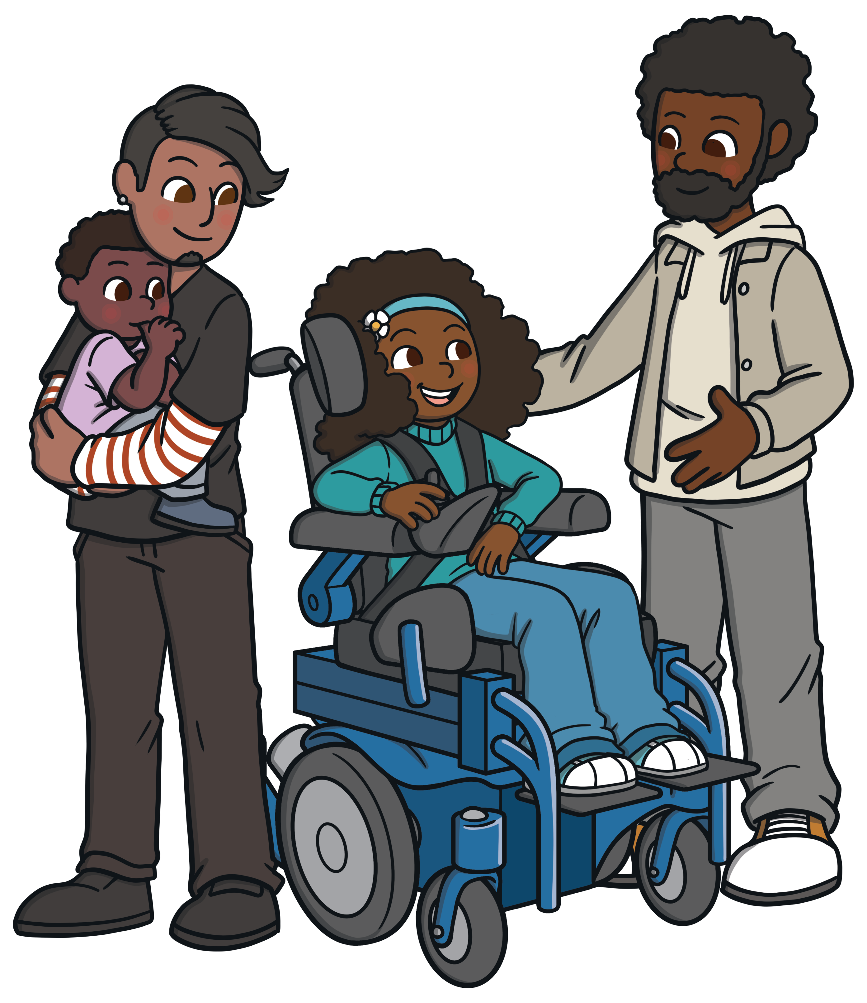
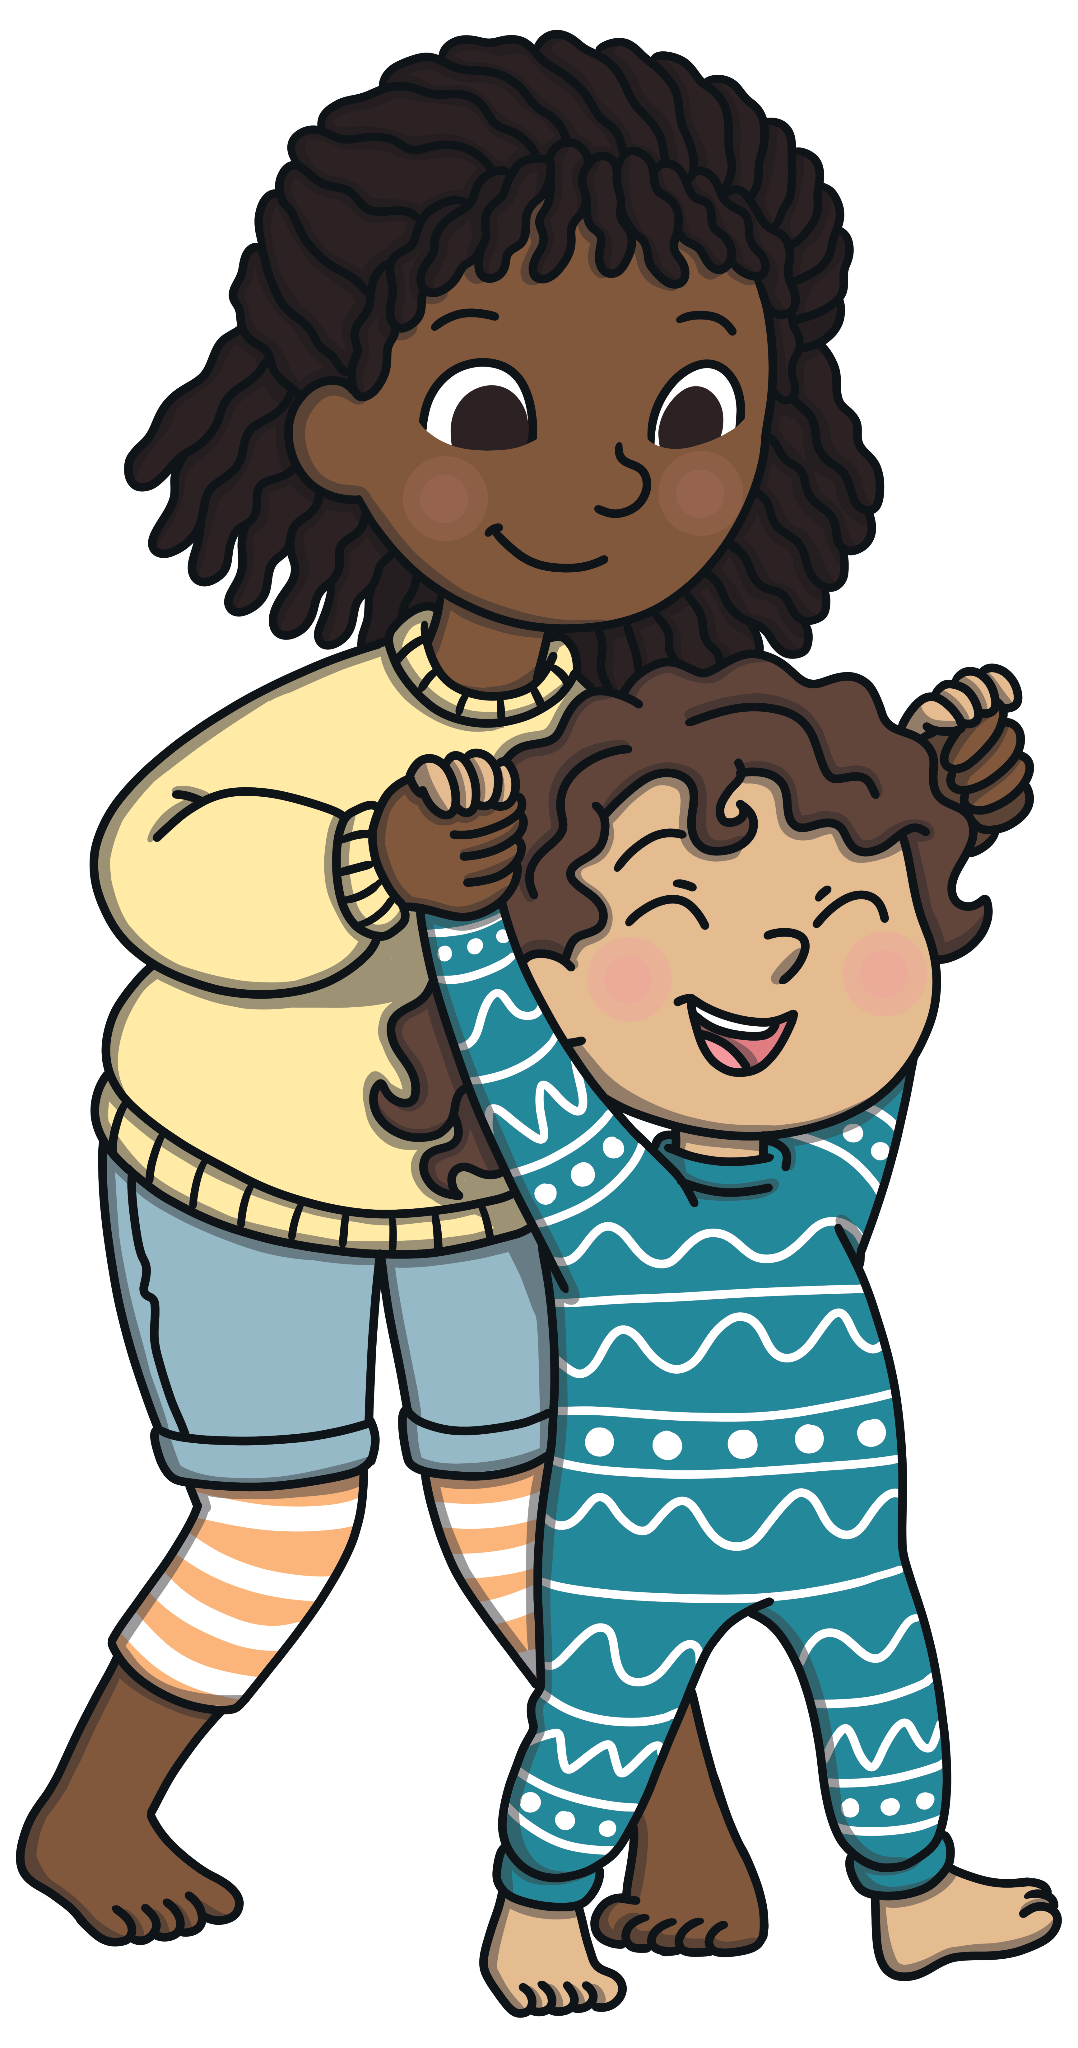
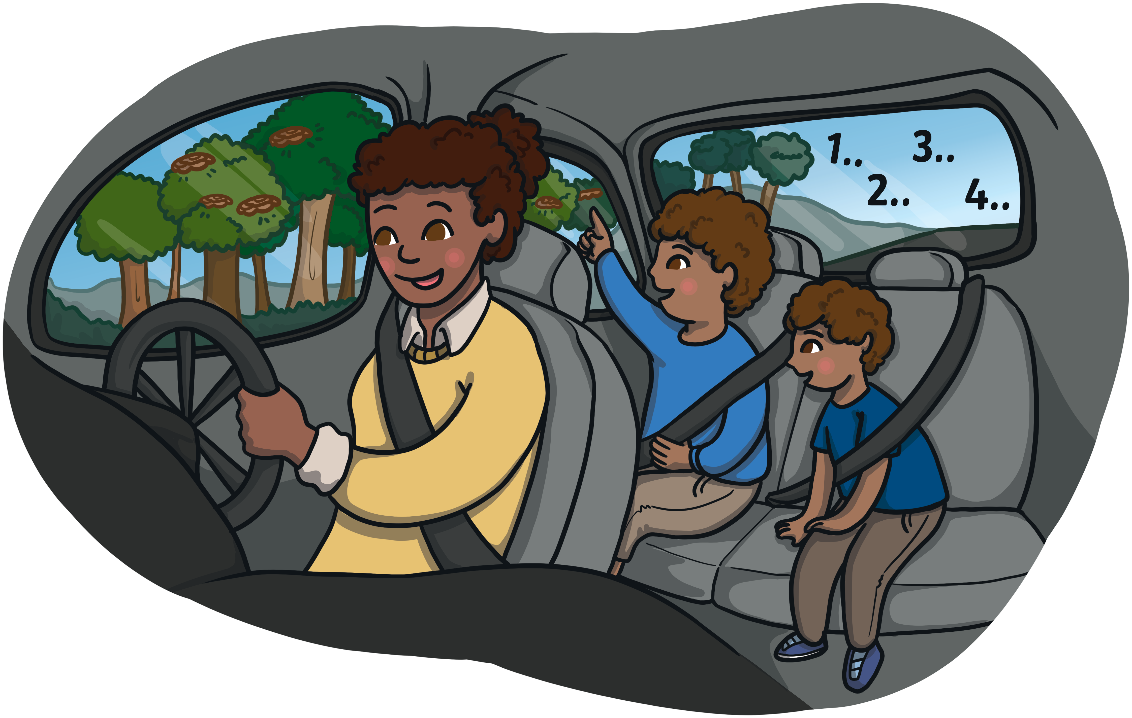


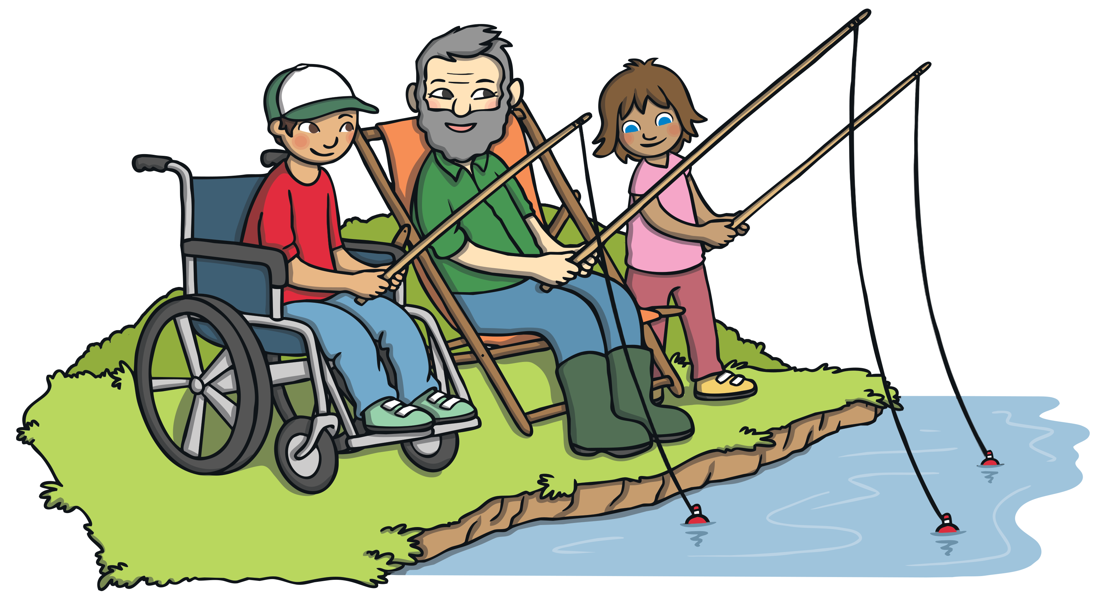
Let’s Practise
Do you remember the name of each family member? Click on the boxes to check the answer.

Slide 10
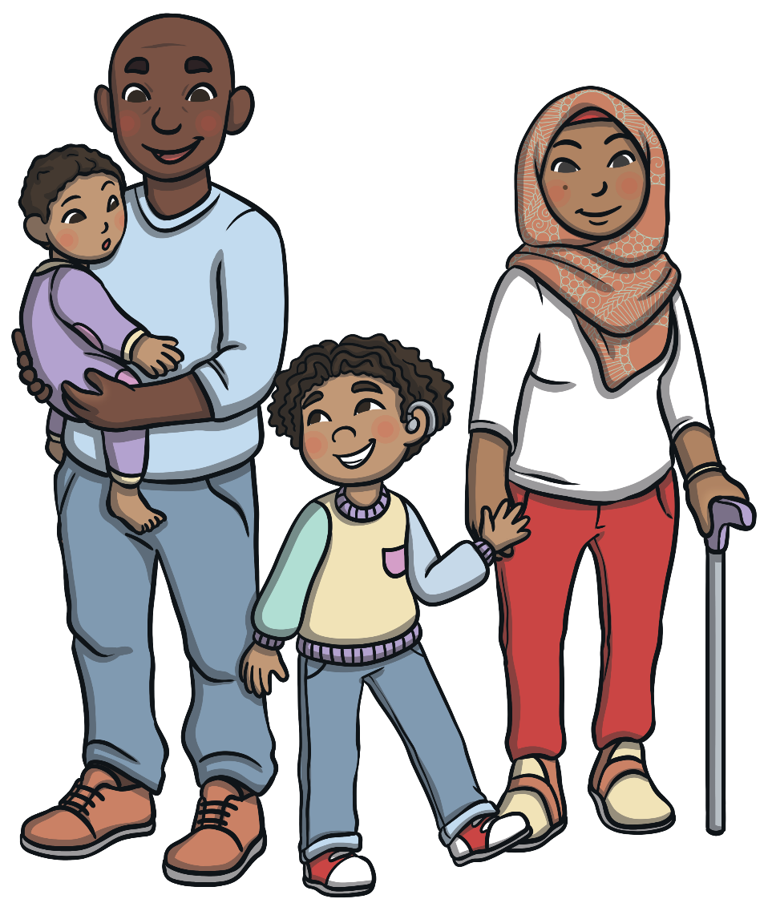
Look at the picture. Who are they?
dad
mum
brother
brother
Reveal Answers

Slide 11
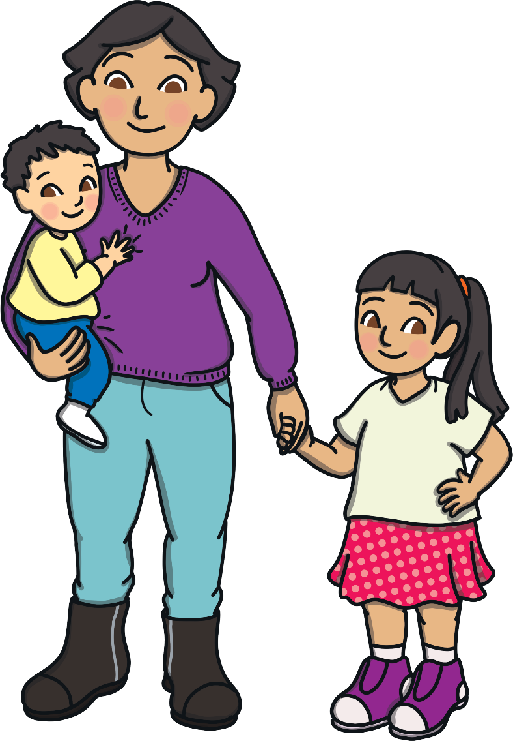
Look at the picture. Who are they?
brother
mum
sister
Reveal Answers

Slide 12
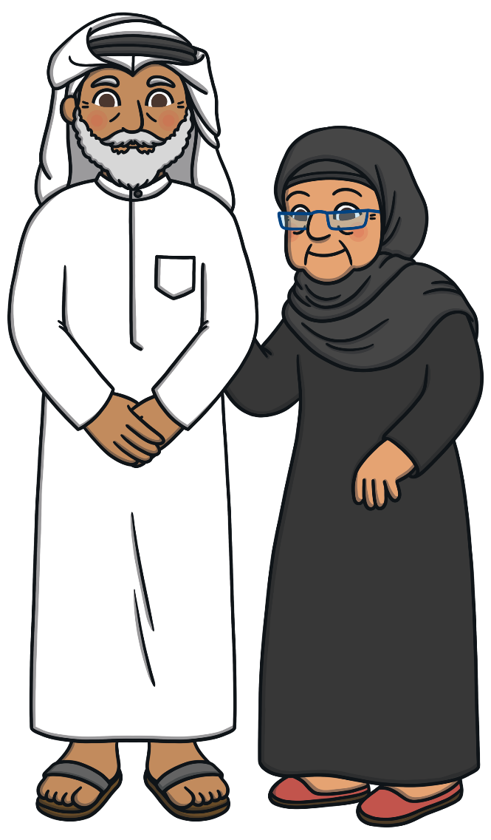
Look at the picture. Who are they?
grandpa
grandma
Reveal Answers

Slide 13
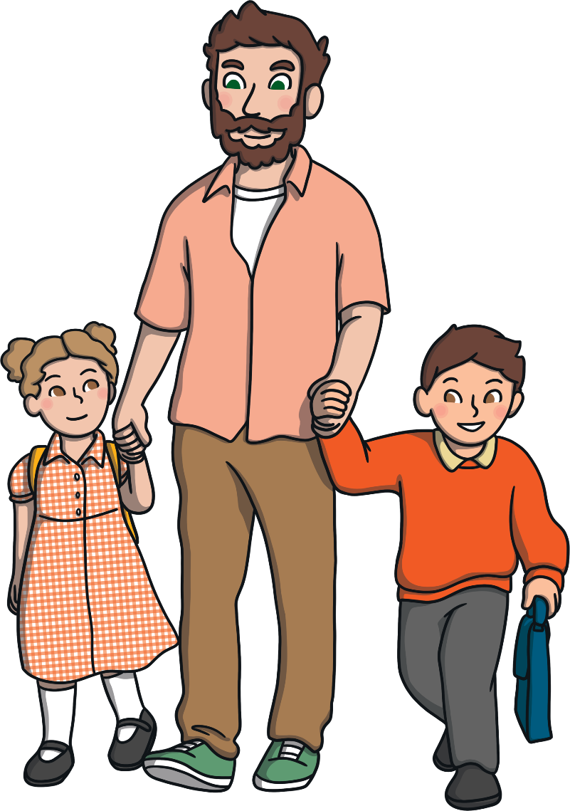
Look at the picture. Who are they?
dad
sister
brother
Reveal Answers

Slide 14
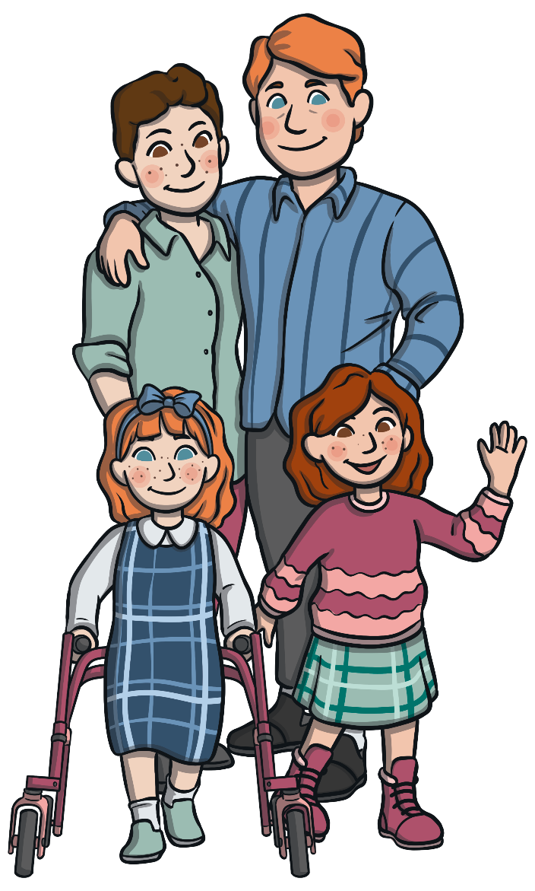
Look at the picture. Who are they?
dad
dad
sister
sister
Reveal Answers

Slide 15
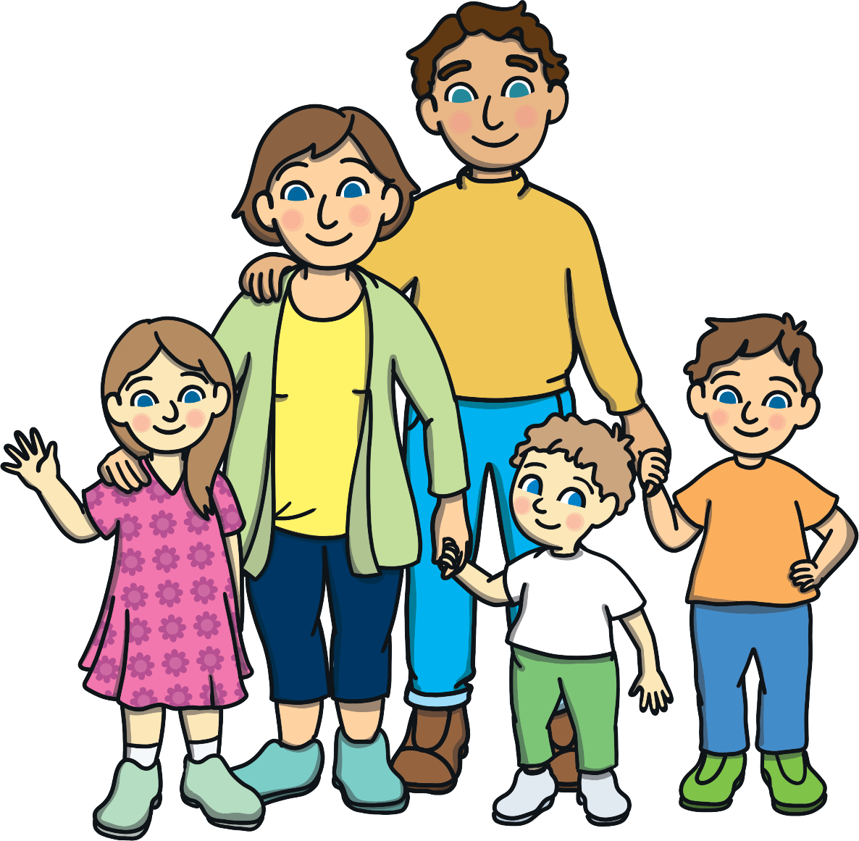
Look at the picture. Who are they?
dad
mum
brother
sister
brother
Reveal Answers

Slide 16
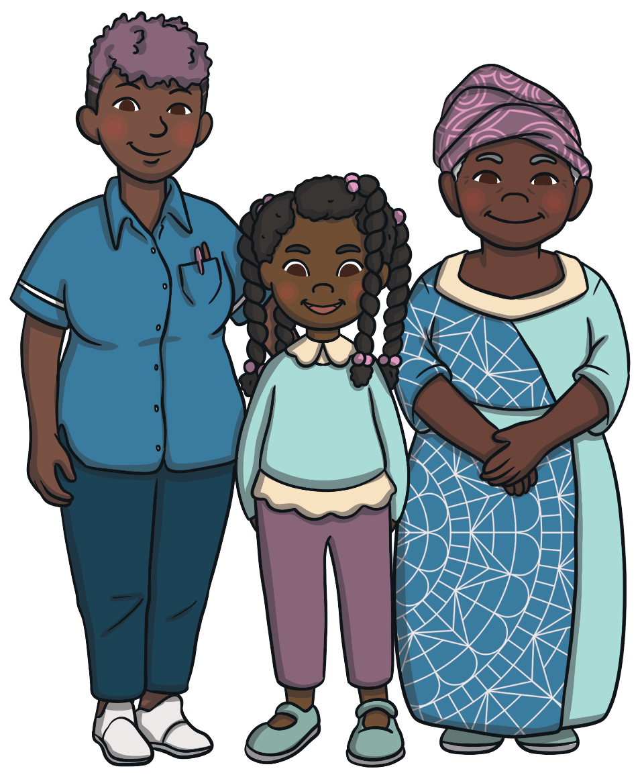
Look at the picture. Who are they?
mum
grandma
sister
Reveal Answers

Slide 17
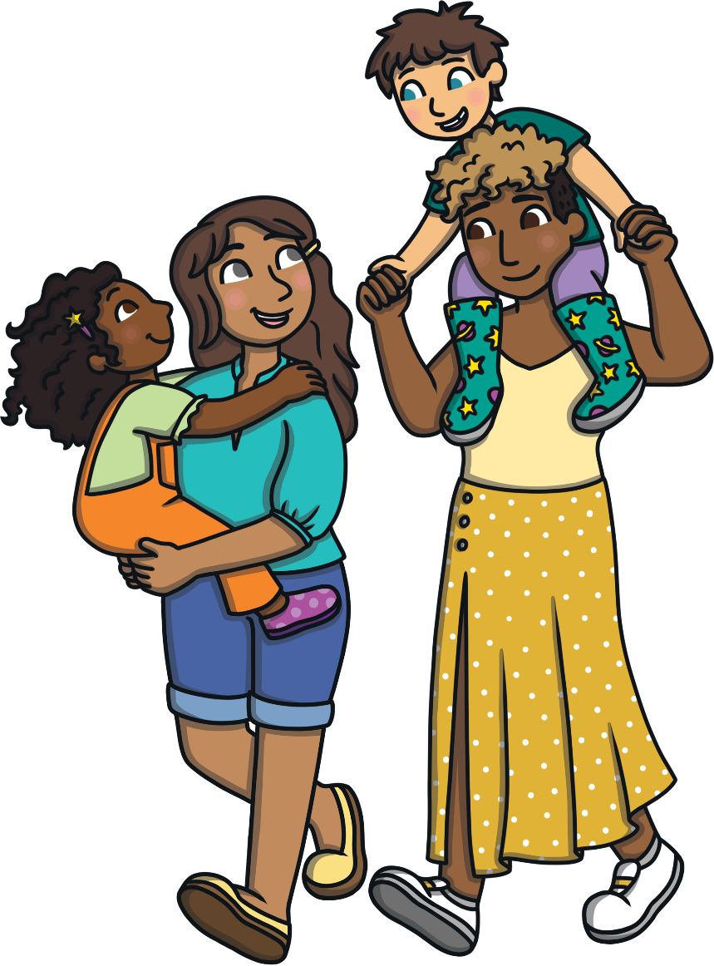
Look at the picture. Who are they?
mum
brother
mum
sister
Reveal Answers

